Slide 1
Develop a RISCV Emulator using C or Python
Presented by:
Aishwarya Patil
Mrunali Fuke
Nikita Jadhav
Praddyumna Joshi
Tejashree Shinde

Slide 2
Content
What is RISCV Emulator
Build your own Distribution
Application of RISCV Emulator
Conclusion

Slide 3
What is RISCV Emulator
software that simulates the behavior of a RISC-V processor
Emulators for RISC-V allow developers to run and test code on a virtual RISC-V processor without needing actual hardware.

Slide 4
Build your own Distribution
Creating a file system hierarchy
Build a cross toolchain
Compliation of busybox
Compling a linux
Preparing an image
Booting in RISCV image in QEMU

Slide 5
Types of RISC-V emulators:
QEMU: A versatile emulator that supports various architectures, including RISC-V.
Spike: The RISC-V ISA simulator developed by the RISC-V Foundation.
Renode: A framework that supports emulation for RISC-V as well as other architectures, focusing on system-level simulation.

Slide 6
The Linux File System
The *Nix (Unix or Linux) file system is a hierarchical directory structure
The structure resembles an upside down tree
Directories are collections of files and other directories. The structure is recursive with many levels.
Every directory has a parent except for the root directory. Many directories have sub-directories.

Slide 7
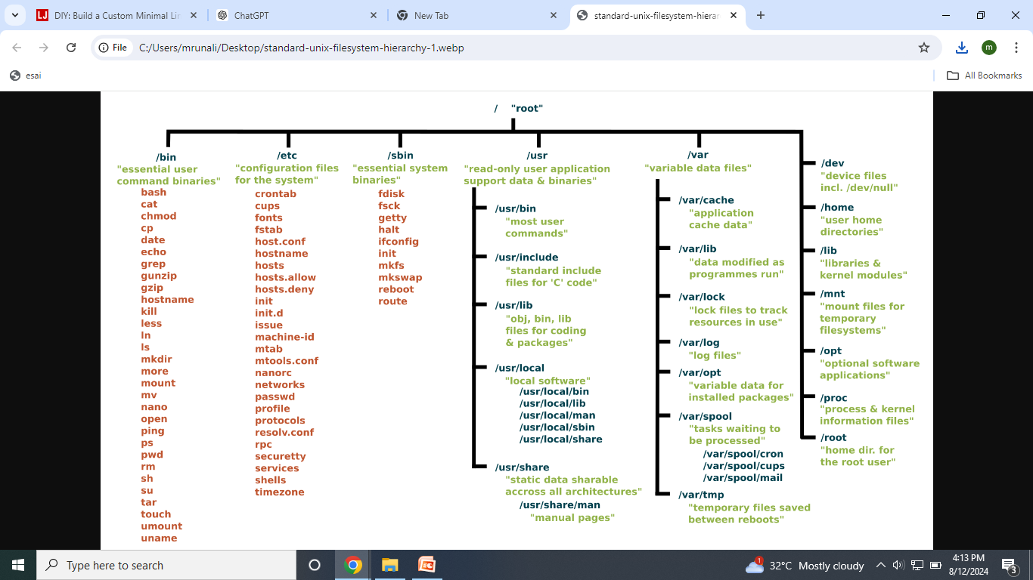
Typical Linux File System view

Slide 8
Various directories in Linux FS
/bin, /sbin : executable files necessary to manage and run the Linux system.
/boot : bootloader files, required to boot the system
/dev : special files used to represent the various hardware devices in the system. E,g, hda, hdb ...
/etc : text-based configuration files used by the system as well as services running on the system.
/home : subdirectories that serve as home directories for each user account.
/lib : code libraries used by programs in /bin and kernel modules (stored in the modules subdirectory)
/mnt , /media : used by some Linux distributions (such as Fedora or Red Hat) to mount external devices.

Slide 9
RISC-V toolchain
components typically included in a RISC-V toolchain:
collection of software tools used to develop applications and systems for RISC-V processors
It includes compilers, assemblers, linkers, and other utilities necessary for building and debugging software that runs on RISC-V hardware or emulators.
Compiler: Converts code into machine code for RISC-V processors.
Assembler: The assembler converts assembly language code into machine code.
Linker: The linker combines multiple object files into a single executable or library, resolving addresses and symbols among the files.
Debugger: Debuggers help you test and troubleshoot your code.
Simulator/Emulator: Tools like QEMU or Spike can simulate RISC-V hardware, allowing you to run and test before deploying it to actual hardware.
Build System: Tools like Make or CMake help manage the build process, defining how source code is compiled and linked into executables or libraries.

Slide 10
RISC-V toolchain
Three machines must be distinguished when discussing toolchain creation
The build machine, where the toolchain is built.
The host machine, where the toolchain will be executed.
The target machine, where the binaries created by the toolchain are executed.

Slide 11
Busybox
It combines many common Unix utilities into a single executable.
BusyBox is a crucial tool for building efficient and functional systems where space and resources are at a premium.
BusyBox operates by recognizing which utility has been called by checking the name it was invoked with (typically using symlinks). For example, if you create a symlink to the BusyBox binary named ls, BusyBox will run its internal ls command when that symlink is executed.

Slide 12
Key Features of BusyBox:
Single Binary:
BusyBox combines many common Unix command-line utilities into a single executable file. These utilities include commands like ls, cp, mv, grep, sed, awk, and more.
Compact and Lightweight:
BusyBox is designed to be extremely small in terms of both disk space and memory usage, which is crucial for embedded systems where resources are limited.
Configurable:
BusyBox can be customized to include only the specific utilities you need. This is done by configuring the build process, allowing you to tailor the binary to your application's requirements.
Utility Coverage:
Despite its small size, BusyBox covers a wide range of functionalities typically required in Unix-like operating systems, from file management and process control to networking and shell utilities.
Embedded Systems:
BusyBox is widely used in embedded Linux systems, such as those running on routers, IoT devices, and small-scale Linux distributions like OpenWrt and Alpine Linux. It provides the necessary functionality to operate a Linux-based system with minimal overhead.
Replacement for Core Utilities:
BusyBox is often used as a replacement for the GNU Core Utilities (coreutils) and other standard Unix tools, offering similar functionality with a smaller footprint.

Slide 13
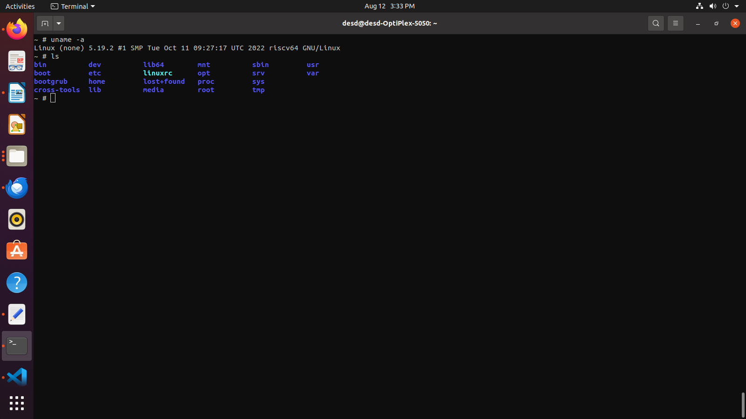
Preparing RISCV Image and booting in Qemu

Slide 14
Application of RISC-V emulator:
Simulation
Debugging
Development
Educational Purposes

Slide 15
Conclusion
RISC-V emulators are crucial tools for anyone working with the RISC-V architecture,
providing a flexible and cost-effective environment for development, testing, and education.
They enable developers to explore the capabilities of RISC-V and build software or hardware
solutions tailored to this open-source architecture.

Slide 16
Refrences
Auler, R., Borin, E.: The case for flexible ISAs: unleashing hardware and software. In: SBAC-PAD 2017 (2017).
Baraz, L., et al.: IA-32 execution layer: a two-phase dynamic translator designed to support IA-32 applications on Itanium®-based systems. In: 36th MICRO (2003).
Bellard, F.: QEMU, a fast and portable dynamic translator. In: USENIX, FREENIX Track(2005).

Slide 17
Any Question ?

Slide 18
Thank You!

